Slide 1
PRSQL-01 · CAPSTONE PROJECT
IMDB Movies
Popularity, profitability, ratings & director diversity — a SQL + Power BI analysis
Prepared by: Sauravi Sarode
Batch / Team: PTID-CDA-SEP-26-11277
Date: 06-10-2026

Slide 2
INTRODUCTION
Objective & Dataset
Objective
Dataset Overview
Analyze a movie industry dataset to answer 13 business questions using SQL, then extend the analysis into an interactive Power BI dashboard covering popularity, profitability, ratings, and director diversity.
Source: MySQL database – project_movie_database
47
2,349
movies
directors on file
Tools Used
Key fields
MySQL – 13 required problem queries
Power BI – dashboard and chart visualization
Microsoft Word / PDF – reporting
movies: title, budget, revenue, popularity, vote_average, vote_count, release_date, director_id
directors: name, gender, department
IMDB Movies — PRSQL-01 Capstone
2

Slide 3
KPIS
Key Performance Indicators
47
2,349
6.60
Total Movies
Total Directors
Average Vote
all records
reference list
out of 10
7.60
215,097
0%
Highest Rated
Total Votes Cast
Movies by Female Directors
The Dark Knight Rises
across all movies
0 of 47 movies
IMDB Movies — PRSQL-01 Capstone
3

Slide 4
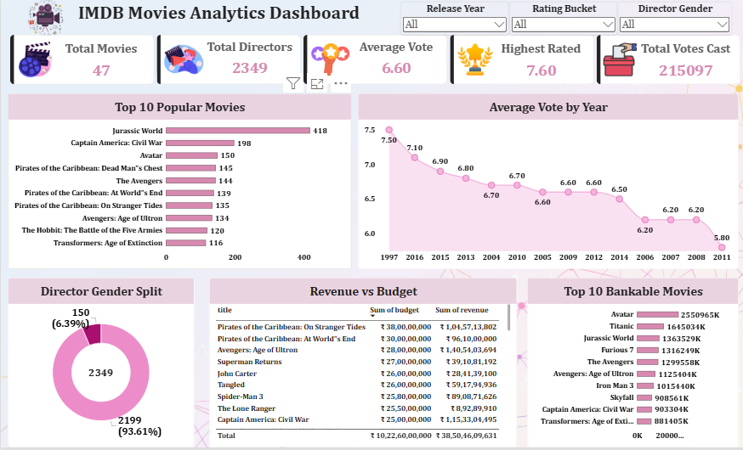
Dashboard
IMDB Movies — PRSQL-01 Capstone
3

Slide 5
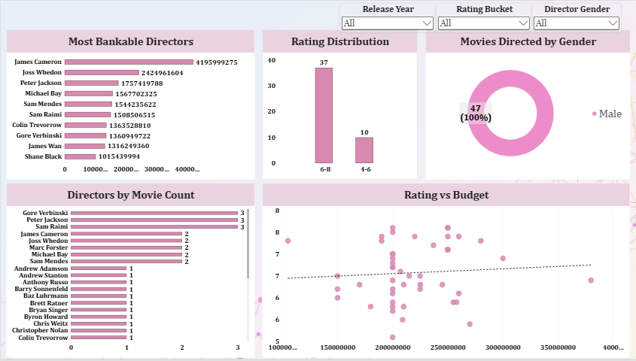
Dashboard
IMDB Movies — PRSQL-01 Capstone
3

Slide 6
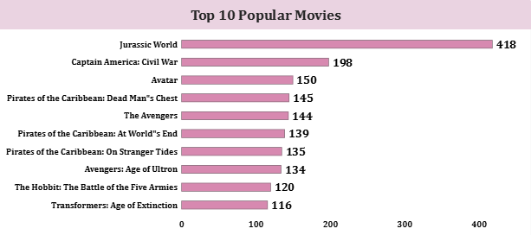
CHART 1 · BAR CHART
Top 10 Popular Movies
[ Paste Top 10 Popular Movies screenshot here ]
INSIGHT
Jurassic World dominates popularity
Jurassic World leads at 418, more than double #2 Captain America: Civil War (198). Avatar (150) completes the top 3. Franchise sequels (3 Pirates films, 2 Avengers films) dominate the top 10.
IMDB Movies — PRSQL-01 Capstone
4

Slide 7
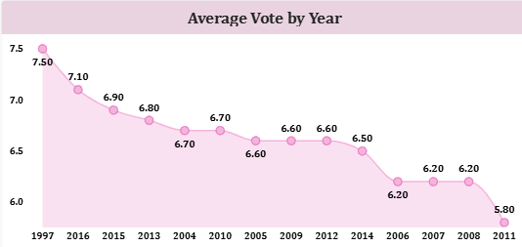
CHART 2 · LINE CHART
Average Vote by Year
[ Paste Average Vote by Year screenshot here ]
INSIGHT
Ratings range 5.8 – 7.5 across years
Highest average rating: 1997 (7.50). Lowest: 2011 (5.80). Axis should be sorted chronologically before final submission to confirm whether a genuine trend exists over time.
IMDB Movies — PRSQL-01 Capstone
5

Slide 8
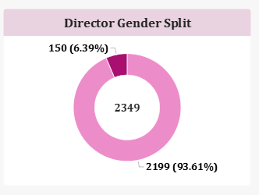
CHART 3 · DONUT CHART
Director Gender Split
[ Paste Director Gender Split screenshot here ]
INSIGHT
6.39% of all directors on file are women
150 of 2,349 directors are female (6.39%), 2,199 are male (93.61%). This reflects the full reference list – compare with the movie-level split on a later slide.
IMDB Movies — PRSQL-01 Capstone
6

Slide 9
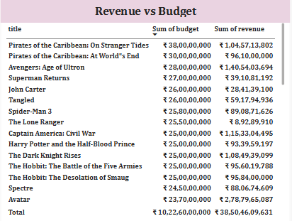
CHART 4 · TABLE
Revenue vs Budget
[ Paste Revenue vs Budget screenshot here ]
INSIGHT
Big budgets don't guarantee big returns
On Stranger Tides (~$380M budget) and Captain America: Civil War (~$250M) both returned over $1B. The Lone Ranger spent ~$255M but earned only ~$89M – a loss of over $165M.
IMDB Movies — PRSQL-01 Capstone
7

Slide 10
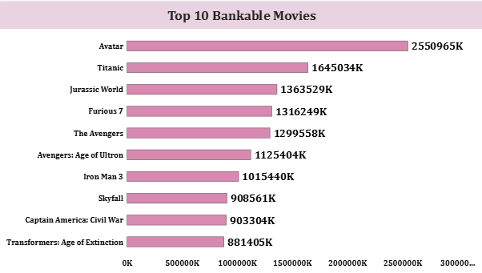
CHART 5 · BAR CHART
Top 10 Bankable Movies
[ Paste Top 10 Bankable Movies screenshot here ]
INSIGHT
Avatar is the clear profit leader
Avatar: $2.55B profit · Titanic: $1.65B · Jurassic World: $1.36B. Only Avatar and Jurassic World also appear on the Popular Movies list – popularity and profit are largely separate signals.
IMDB Movies — PRSQL-01 Capstone
8

Slide 11
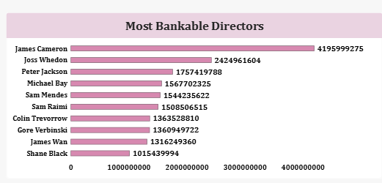
CHART 6 · BAR CHART
Most Bankable Directors
[ Paste Most Bankable Directors screenshot here ]
INSIGHT
James Cameron leads from just 2 movies
James Cameron: $4.196B total profit from only 2 films (Avatar, Titanic) – nearly double #2 Joss Whedon ($2.42B). Profit is concentrated in a few blockbuster hits, not spread evenly across prolific directors.
IMDB Movies — PRSQL-01 Capstone
9

Slide 12
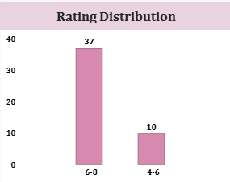
CHART 7 · COLUMN CHART
Rating Distribution
[ Paste Rating Distribution screenshot here ]
INSIGHT
Ratings cluster in the 6–8 band
37 of 47 movies (79%) rate 6-8. The remaining 10 (21%) rate 4-6. No movie rates below 4 or above 8 – a narrow, above-average spread suggesting a pre-filtered, notable-films dataset.
IMDB Movies — PRSQL-01 Capstone
10

Slide 13
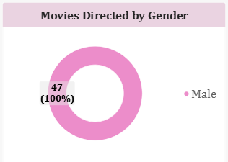
EXTRA INSIGHT · DONUT CHART
Movies Directed by Gender
[ Paste Movies Directed by Gender screenshot here ]
INSIGHT
100% of movies were male-directed
All 47 movies in this dataset were directed by men – 0% by women, despite 150 female directors existing on file. This is the most significant finding in the entire analysis.
IMDB Movies — PRSQL-01 Capstone
11

Slide 14
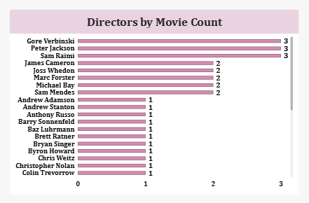
CHART 8 · BAR CHART
Directors by Movie Count
[ Paste Directors by Movie Count screenshot here ]
INSIGHT
Three-way tie for most movies directed
Gore Verbinski, Sam Raimi, and Peter Jackson are tied at 3 movies each. Five more directors (James Cameron, Joss Whedon, Marc Forster, Michael Bay, Sam Mendes) each directed 2.
IMDB Movies — PRSQL-01 Capstone
12

Slide 15
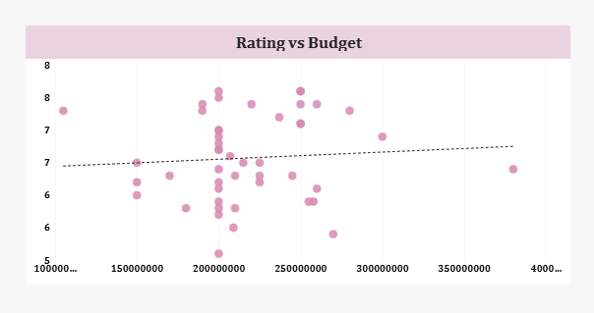
EXTRA INSIGHT · SCATTER CHART
Rating vs Budget
[ Paste Rating vs Budget screenshot here ]
INSIGHT
Budget does not predict rating
The trend line across budget vs. vote_average is nearly flat. High and low ratings both occur across the full $100M–$380M budget range – spending more doesn't buy a better rating.
IMDB Movies — PRSQL-01 Capstone
13

Slide 16
SQL RESULTS
13 Problem Queries — Answer Summary (Q1–Q7)
Q1
Get all data about movies
All 47 movie records retrieved
Q2
Get all data about directors
All 2,349 director records retrieved
Q3
How many movies are in IMDB?
47
Q4
Find James Cameron, Luc Besson, John Woo
All 3 found (Dept: Directing)
Q5
Directors with name starting with S
List retrieved (see SQL doc)
Q6
Count of female directors
150
Q7
10th first female director
Angelina Jolie
IMDB Movies — PRSQL-01 Capstone
14

Slide 17
SQL RESULTS
13 Problem Queries — Answer Summary (Q8–Q13)
Q8
3 most popular movies
Jurassic World, Captain America: Civil War, Avatar
Q9
3 most bankable movies
Avatar, Titanic, Jurassic World
Q10
Highest avg vote since Jan 1, 2000
The Dark Knight Rises (2012) – 7.6
Q11
Movie(s) directed by Brenda Chapman
None found in this dataset
Q12
Director with the most movies
3-way tie: Verbinski, Raimi, Jackson (3 each)
Q13
Most bankable director
James Cameron – $4.196B total profit
IMDB Movies — PRSQL-01 Capstone
15

Slide 18
FINDINGS
Insights Summary
Popularity vs Profit
Director Diversity
Mostly different lists – only Avatar & Jurassic World appear on both.
0% of movies were female-directed, vs 6.39% of all directors on file.
Budget ≠ Success
Hit Concentration
No reliable link between budget and rating or revenue.
James Cameron: $4.2B profit from just 2 movies – beats directors with 2-3x the films.
Rating Spread
Movie Count Tie
79% of movies rate 6-8; none below 4 or above 8.
3 directors tied at 3 movies each: Verbinski, Raimi, Jackson.
IMDB Movies — PRSQL-01 Capstone
16

Slide 19
ACTION PLAN
Recommendations
1
Investigate the zero female-directed movies finding — 150 female directors are on file, but none are linked to the 47 movies analyzed. Review dataset sourcing or confirm this reflects a genuine historical gap.
2
Track profit and popularity separately — since the most popular and most bankable movies are largely different lists, both metrics matter independently for future decisions.
3
Scrutinize high-budget projects — The Lone Ranger and Superman Returns show real downside risk from large budgets. Case-study what differed from successes like On Stranger Tides.
4
Study James Cameron's high-profit, low-volume model — his 2-movie, $4.2B profit record outperforms directors with far more films.
5
Fix the Average Vote by Year chart's axis sort before final submission so the year-over-year trend is readable at a glance.
IMDB Movies — PRSQL-01 Capstone
17

Slide 20
CONCLUSION
47 movies, 2,349 directors on file, and a dataset where blockbuster hits — not budget size — drive profitability.
The standout finding: despite 150 female directors on file (6.39%), 0% of the 47 movies analyzed were directed by a woman. Combined with the weak link between budget and success, this points to two clear priorities — investigating representation in the dataset, and evaluating projects on profit potential rather than spend alone.
Thank you

